Slide 1

Predicting Movie Box Office Revenue Using Machine Learning machine learning project that predicts movie box office revenue using movie features
Presented by : Lokeswari Yaratapalli
MSc Data Science
UNIVERSITY OF HERTFORDSHIRE
https://github.com/sriloki4887/TMDB-Research-project-.git

Slide 2
Research Question
Can movie features such as budget, runtime, genre, popularity, vote average and vote count predict box office revenue?
Revenue Prediction - Can machine learning models predict movie box office revenue accurately?
2. Key Features - Which movie features influence revenue the most?
3. Financial Decision Making - Can predictive analytics support movie production planning?
4. Feature Relationships - How do budget, popularity, and ratings affect revenue?

Slide 3
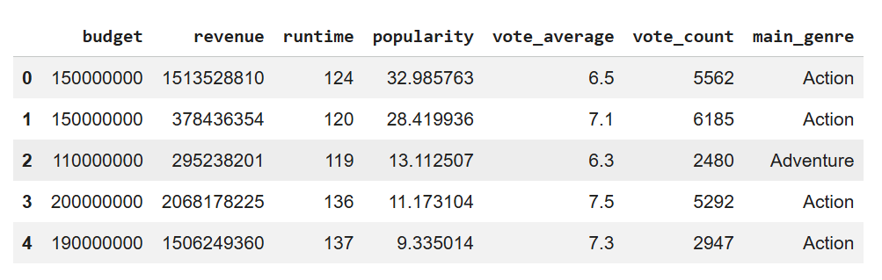
DATASET & ethics
Source: TMDB Movie Dataset (real-world movie metadata)
Records: 10,000+ movies after preprocessing
Features: Budget, Runtime, Genre, Popularity, Vote Average, Vote Count
Ethics: Dataset is public and contains no personal or sensitive information.

Slide 4
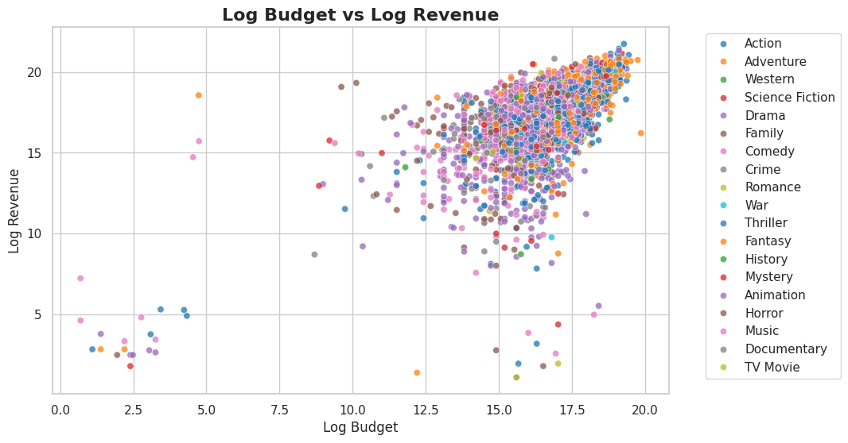
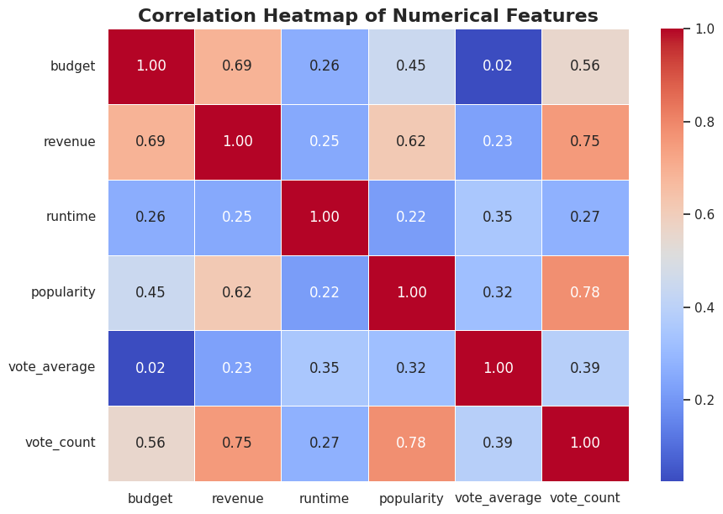
EXPLORATORY DATA ANALYSIS
Budget vs Revenue
Higher-budget movies generally earn more revenue.
Genre Analysis
Certain genres perform better commercially.
Popularity & Votes
Popularity and vote count show strong influence on revenue.
Correlation Heatmap
Budget and popularity have strongest correlation with revenue.

Slide 5
data preprocessing
Remove missing & zero values
Extract main genre
Apply log transformation
Feature scaling & encoding
Train-test split (80/20)
“A clean dataset improves model reliability and prediction accuracy.”

Slide 6
Models used
Linear Regression - Baseline regression model for comparison.
Random Forest Regressor - Captures non-linear relationships using decision trees.
Gradient Boosting Regressor - Sequential ensemble model that improves prediction accuracy by correcting previous errors.
MLP Regressor - Learns complex patterns through multiple hidden layers.
“All models were trained and evaluated on the same dataset.”

Slide 7
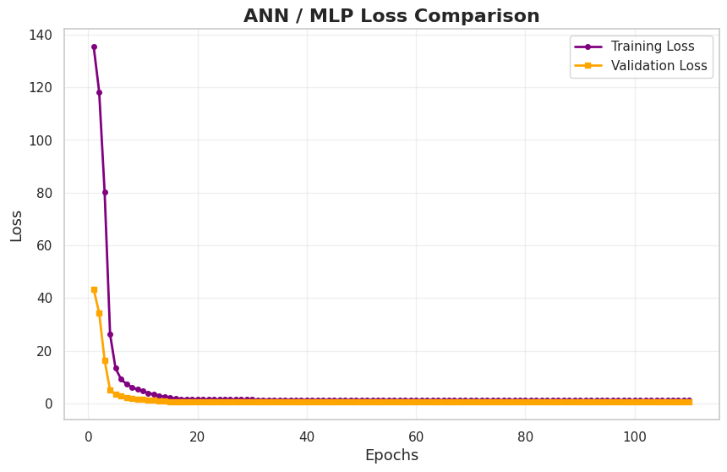
Model training
Linear Regression - Used as baseline performance model.
Random Forest - Ensemble learning with multiple trees.
MLP Regressor - Multi-layer neural network trained using backpropagation.
Training Process
Feature scaling
One-Hot-Encoding
Pipeline preprocessing
500 iterations

Slide 8
Model training
MLP Training
Neural network trained using backpropagation
ReLU activation function
Adam optimizer
Multiple epochs for optimization
2. Gradient Boosting Training
Sequential learning approach
Each tree corrects previous prediction errors
Improves overall prediction accuracy

Slide 9
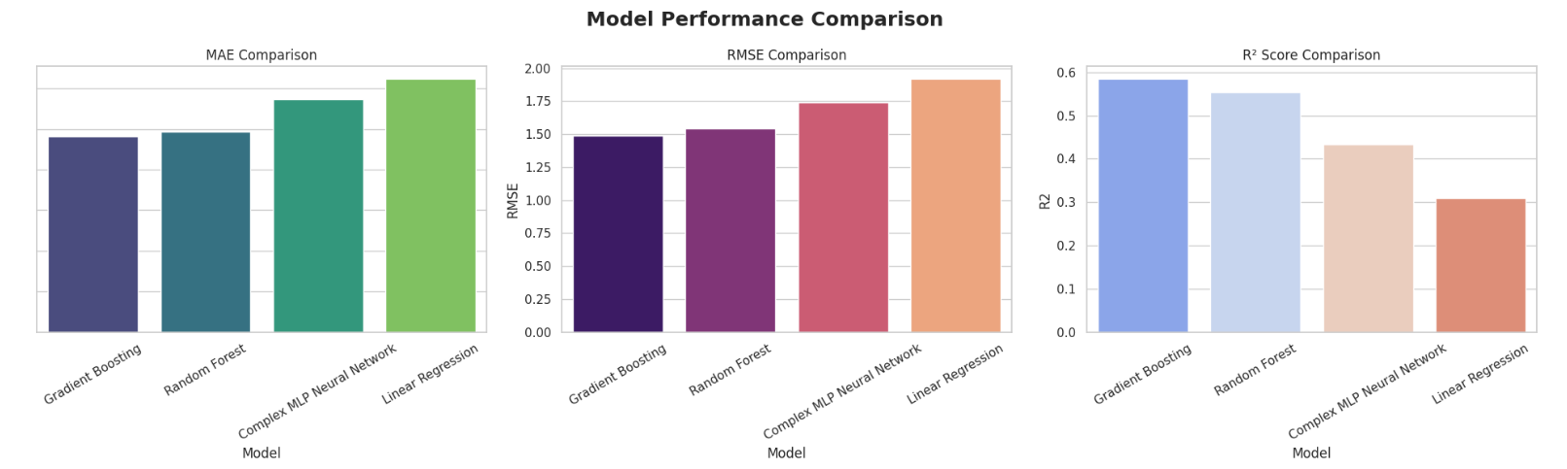
MODELS RESULTS
MLP Regressor - Highest R² score and strongest prediction performance.
Random Forest - Strong performance with good generalization.
Linear Regression - Lowest performance due to linear assumptions.
Gradient Boosting Regressor - achieved the best overall performance.
“Gradient Boosting captured complex non-linear relationships more effectively than other models.”

Slide 10
feature importance analysis
Budget - Strongest predictor of revenue.
Popularity - Highly influential for box office success.
Vote Count - Reflects audience engagement.
Genre - Certain genres generate higher revenue.
Feature Engineering Helped Ensemble Models
Improved learning quality
Reduced skewness
Enhanced model performance

Slide 11
CONCLUSION & future work
ML Effectiveness - Machine learning models successfully predicted movie box office revenue.
Best Model - Gradient Boosting Regressor achieved the best overall performance.
Key Insight - Budget, popularity, and vote count were the most influential features.
Future Work
Future improvements can include:
marketing budget
actor popularity
release timing
social media trends

Slide 12
Thank you

